Slide 1
Week 1

Slide 2

Math Corner-
There are nine puppies in the yard.
Six more come to join them.
How many puppies are there altogether?

Slide 3
Math Corner
What number is ten less than 75? How do you know? Draw a model.

Slide 4
Math Corner-Open Response
Brett got some books from the library. The dot on the number line shows how many books Brett has that belong to him. Each hop shows a book Brett got at the library.
Part A
How many books did Brett start with? Explain your answer.
Part B
How many books did Brett get from the library? Explain your answer.
Part C
Write the addition problem that shows how many books Brett has after he goes to the library.
Part D
Write a subtraction problem to show how many books Brett will have after he gives the books back to the library.

Slide 5
Math Corner
Katie has 11 ice cream bars. She gave 3 ice cream bars to her friends. How many ice cream bars does she have now? Draw a model.

Slide 6
Math Corner
1. How many fingers are there on three hands?
2. How many more fingers would we need to make 20?

Slide 7
Week 2

Slide 8
Math Corner
Your number is 27.
How can you decompose this number?
What addition sentences can your create?
Can you think of more than one way?

Slide 9
Math Corner
Skip count by 3’s from 0-30.
__, __, _6_, __, __,
__, __, _24_, __, __

Slide 10
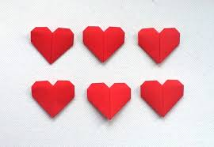
Math Corner-Open Response
Addison has the number of hearts shown.
Part A
How many hearts does Addison have?
Part B
Addison is given 4 more hearts. She counts to add the 4 hearts to Part A. What are the 4 numbers Addison counted?
Part C
If Addison gives 5 hearts away to a friend, how many hearts does she have now? Show your work.

Slide 11
Math Corner
Look at the numbers below and think about place value. Can you tell how many tens and ones are in each number? Use a T-Chart to help you!
21, 49, 13, 27, 72

Slide 12
Math Corner
Consuela has two dimes.
Lane has 20 pennies.
Who has more? Prove your thinking.

Slide 13
Math Corner
Skip count backwards by 10’s from 100-0.
100, __, __, __, __,
__, __, __, __, __, __

Slide 14
Week 3

Slide 15
Math Corner-
What number is one less than 42?
What number is one more?
What number is ten less?
What number is ten more?
How do you know? Draw a model.

Slide 16
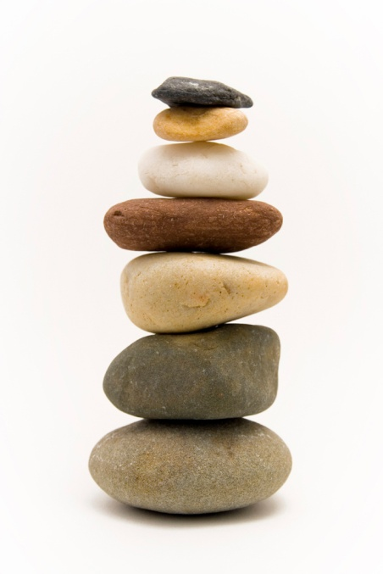
Math Corner
Sally has a rock collection. When her mother asked her how many rocks she had, she said that she had five tens and six ones. How many rocks are in Sally’s collection?
What if Sally had 10 more rocks. How many would that be?

Slide 17

Math Corner
Cathy has sixty-seven coins in her coin collection book. 5 coins fell out of her book. How many coins does she have now?
How can you prove your thinking?

Slide 18
Math Corner-Open Response
Ray looks at the weather each day at noon. The table shows the kind of weather Ray saw each
day.
Part A
How many snowy days did Ray see?
Part B
How many sunny days did Ray see?
Part C
How many more snowy days did Ray see than sunny days? Show your work.
Part D
Ray records 6 more rainy days. Explain how the table changes.

Slide 19
Math Corner
The number is 88. Can you tell:
10 more?
10 less?
Five more?
Five less?

Slide 20
Math Corner
Mrs. Jordan has 18 students. 10 of them are girls. How many are boys? Solve with pictures, numbers, and words.

Slide 21
Math Corner
Using today’s lunch choices,
Create a tally table.
Create a bar graph.
Write 3 questions that can be answered from this data.

Slide 22
Week 4

Slide 23
Math Corner
Today’s number is :10
How many ways can you think of to ADD to reach this SUM?
How many ways can you think of to subtract to reach this DIFFERENCE?
**Bonus: Create a fact family using the numbers 4, 3, and 7

Slide 24
Math Corner
Your numbers are :
2, 6, and 8
Use these numbers to make an addition sentence.
Use these numbers to make a subtraction sentence.
Can you create the ENTIRE fact family?

Slide 25

Math Corner-Open Response
Yesterday morning there were puppies at the Pet Store.
Part A
How many puppies needed a new home?
Part B
Today there are 6 more puppies for sale. How many puppies are there now? Use pictures, numbers, or words, to show your work.
Part C
Ten people come and buy puppies. How many puppies still need a new home? How can you prove your thinking?

Slide 26
Math Corner
Kevin has some ice cream bars. He gave 7 ice cream bars to his friends. Now he has 2 bars left. How many ice cream bars did he start with? Draw a model.
**Bonus: Create a fact family using the numbers 4, 7, and 11

